Slide 1







ENDOSCOPIC SLEEVE GASTROPLASTY – FRENCH EXPERIENCE
Dr Thibaut COSTE, metabolic bariatric surgery and endoscopy, Montpellier - Sète, FRANCE
www.costhau.com
www.moinstranspirer.com
YouTube Channel: centre de chirurgie générale et digestive sétois

Slide 2
Conflict of interest
Echo Vitalis / David Veryking surgical
MID – Care
I have non conflict of interest regarding this presentation

Slide 3
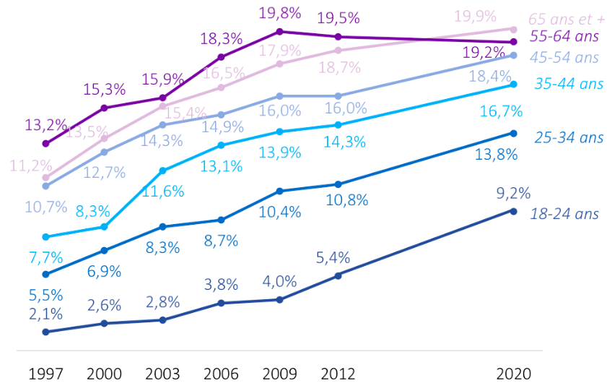
Obesity in France
17% of obesity (BMI ≥ 30)
12% 30-35
3% 35-40
2% > 40
Indication and reimbursment of MBS in France
BMI of 40 kg/ m2 (obesity class III)
35 kg/m2 (obesity class II) with comorbidities
30kg/m2 with unstable diabetes
Nocca et al. Prevalence of Overweight and Obesity in France: The 2020 Obepi-Roche Study by the “Ligue Contre l’Obésité”

Slide 4
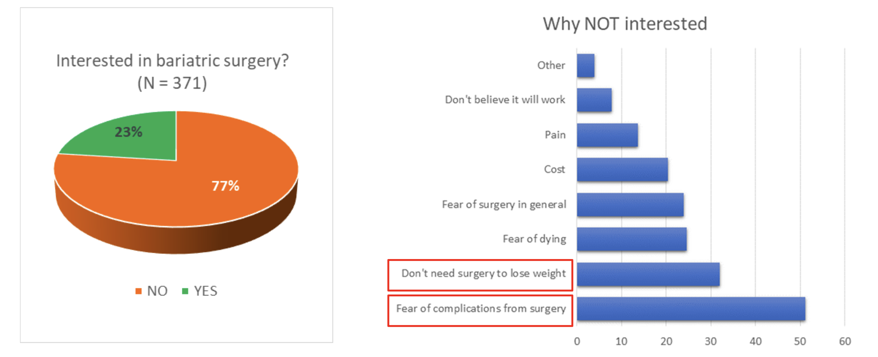
Obesity in France
However, only 1–2% of eligible patients undergo surgery
And 12% of the obese population don’t have access to surgery
Fung M, Wharton S, Macpherson A, Kuk JL. Receptivity to Bariatric Surgery in Qualified Patients. J Obes. 2016;2016:5372190. doi: 10.1155/2016/5372190. Epub 2016 Jul 19. PMID: 27516900; PMCID: PMC4969542. (N=284)

Slide 5

The gap
Large treatment gap between the needs of patients suffering from obesity and what we can offer

Slide 6
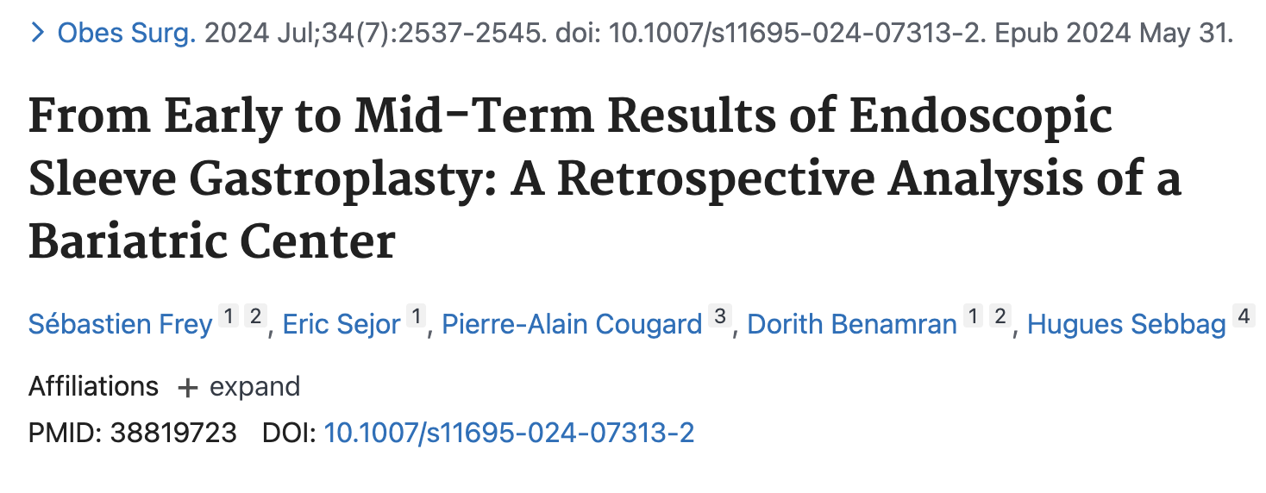
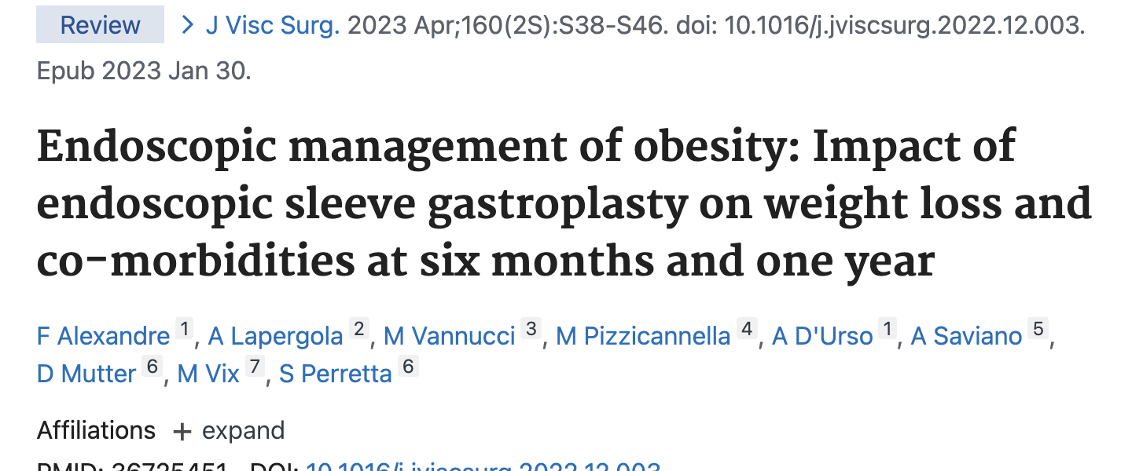
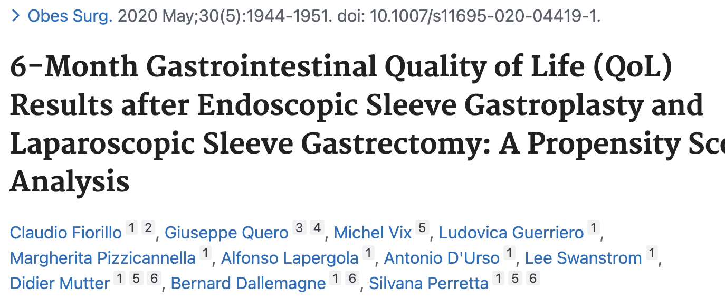
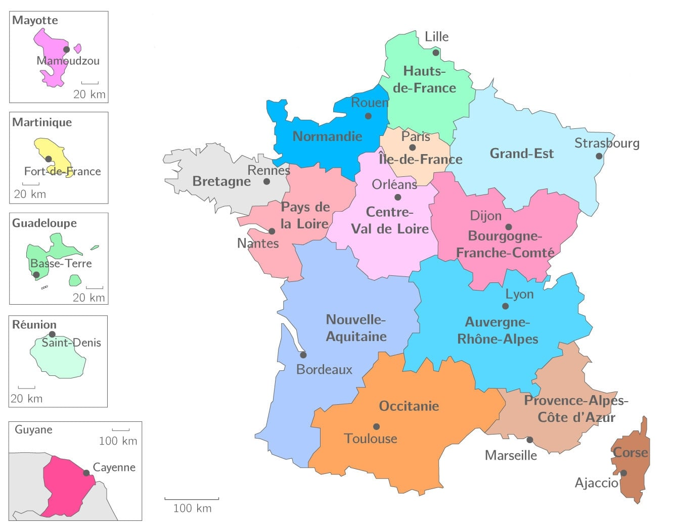
French results
%TWL around 15% at one years
Improvment of QoL
Challenging long term efficacy

Slide 7
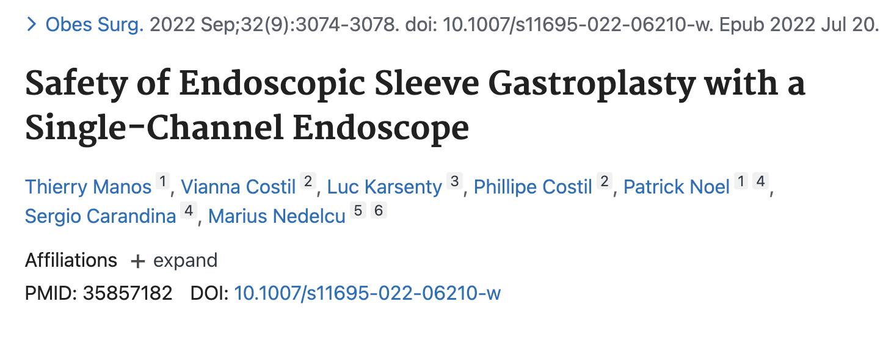
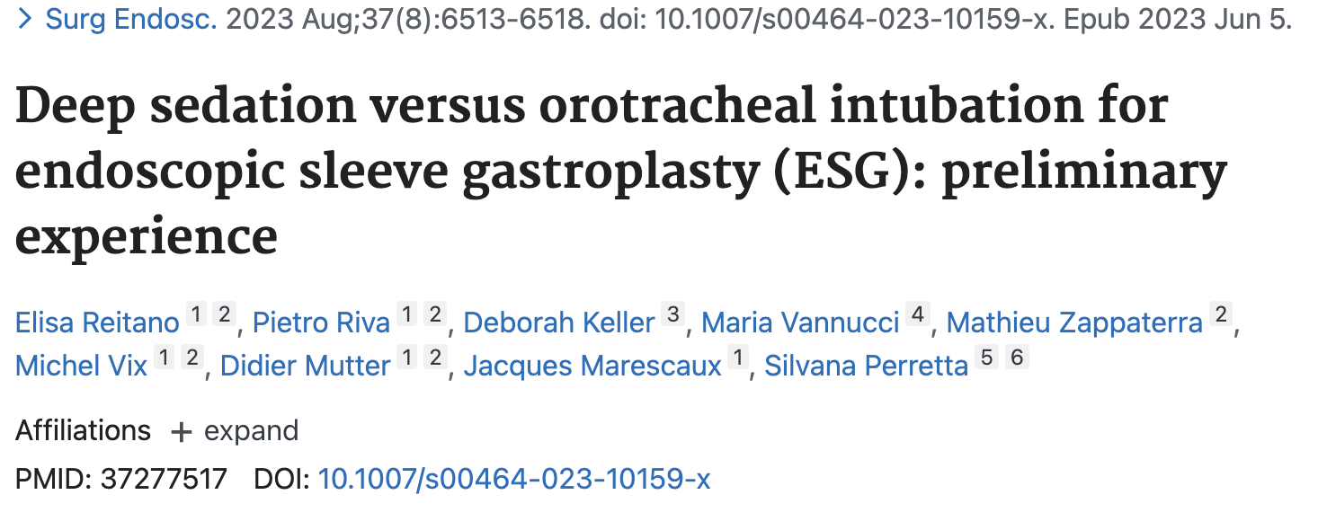
French results
Good safety profile (1% of severe complication)
Possible under deep sedation

Slide 8
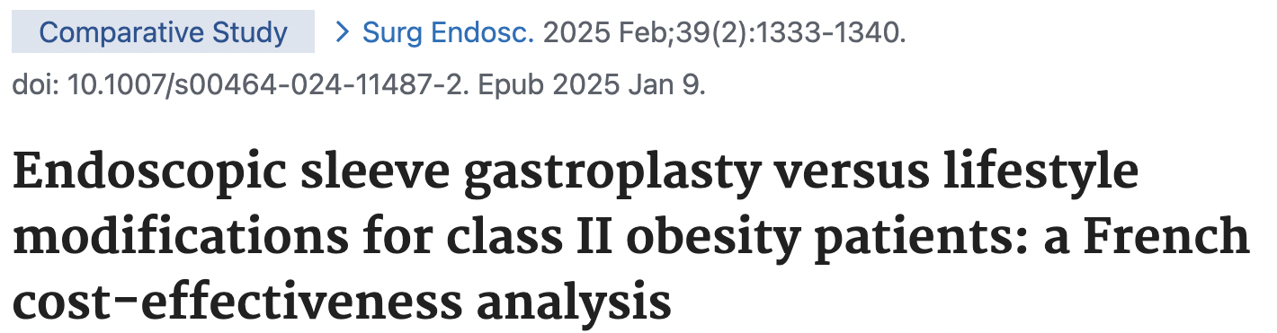
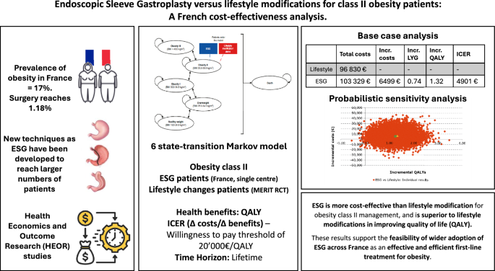
French results
ESG french cohort vs MERIT trial group control
Class 2 obesity
ESG is more cost effective compare to lifestyle modification
ESG is more effective in improving quality of life.
Vannucci M, Riva P, Vix M, Mutter D, Keller DS, Perretta S. Endoscopic sleeve gastroplasty versus lifestyle modifications for class II obesity patients: a French cost-effectiveness analysis. Surg Endosc. 2025 Feb;39(2):1333-1340. doi: 10.1007/s00464-024-11487-2. Epub 2025 Jan 9. PMID: 39789230.

Slide 9
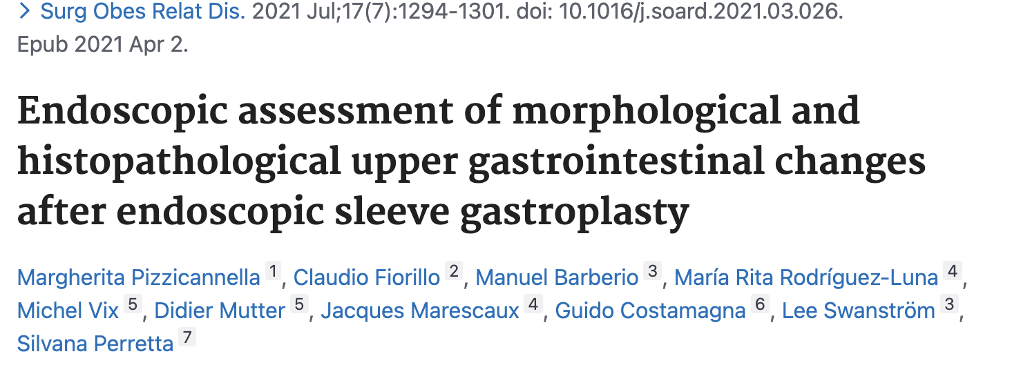
ESG in the time
does not promote the new onset of macroscopic and histopathologic abnormalities within 1-year follow-up

Slide 10
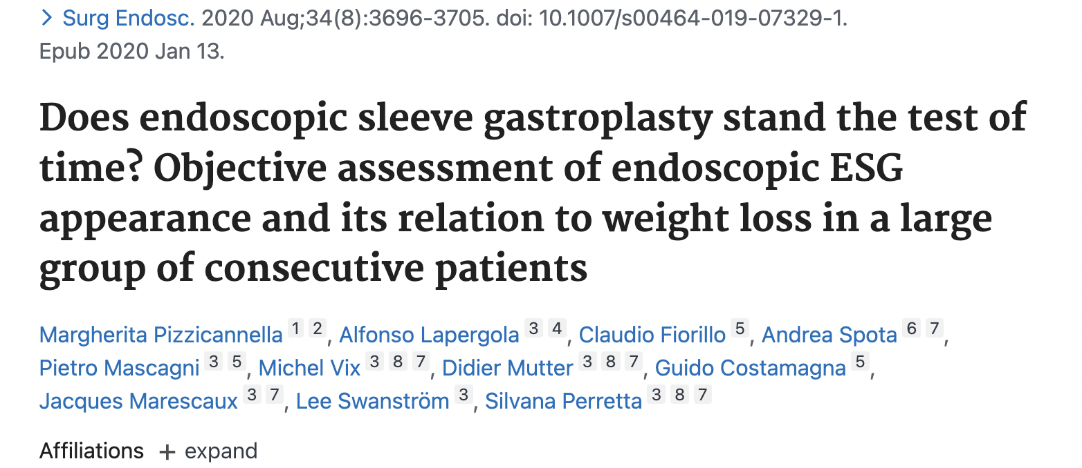
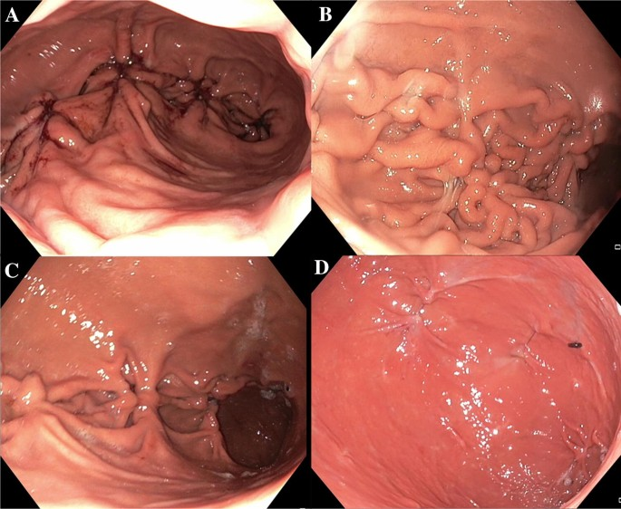
ESG in the time
41 patients at 1 year
10 (24.4%) had an intact ESG ----------------------------------- 17.2% TWL
24 (58.5%) had a partially intact gastroplasty -------------- 13.1% TWL
7 (17.0%) cases the sutures were lost ------------------------ 8.9% TWL

Slide 11
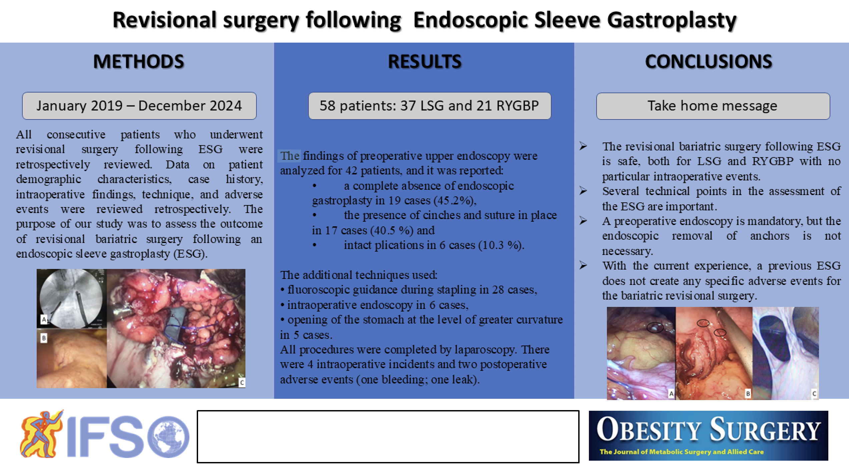

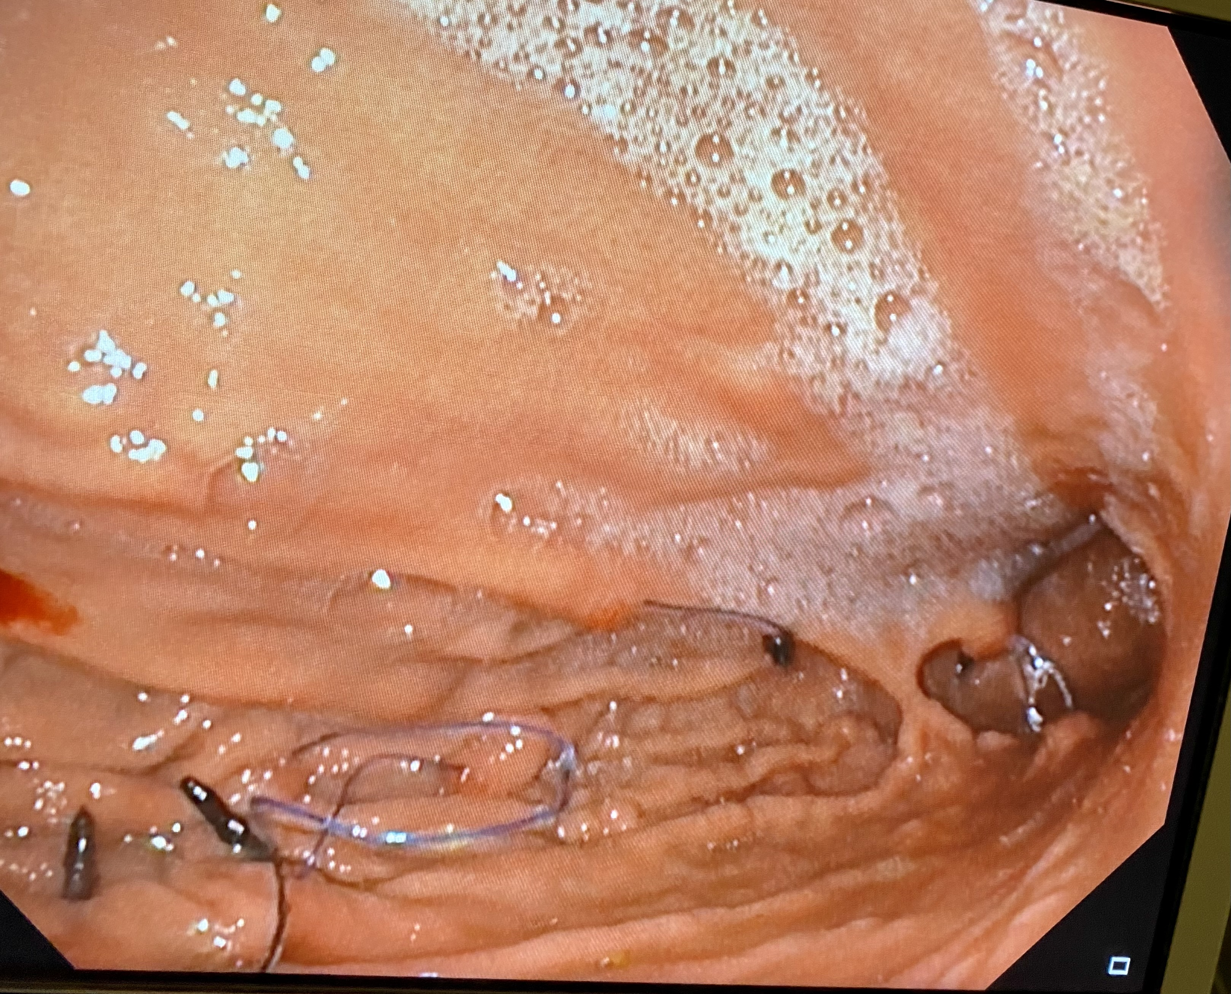
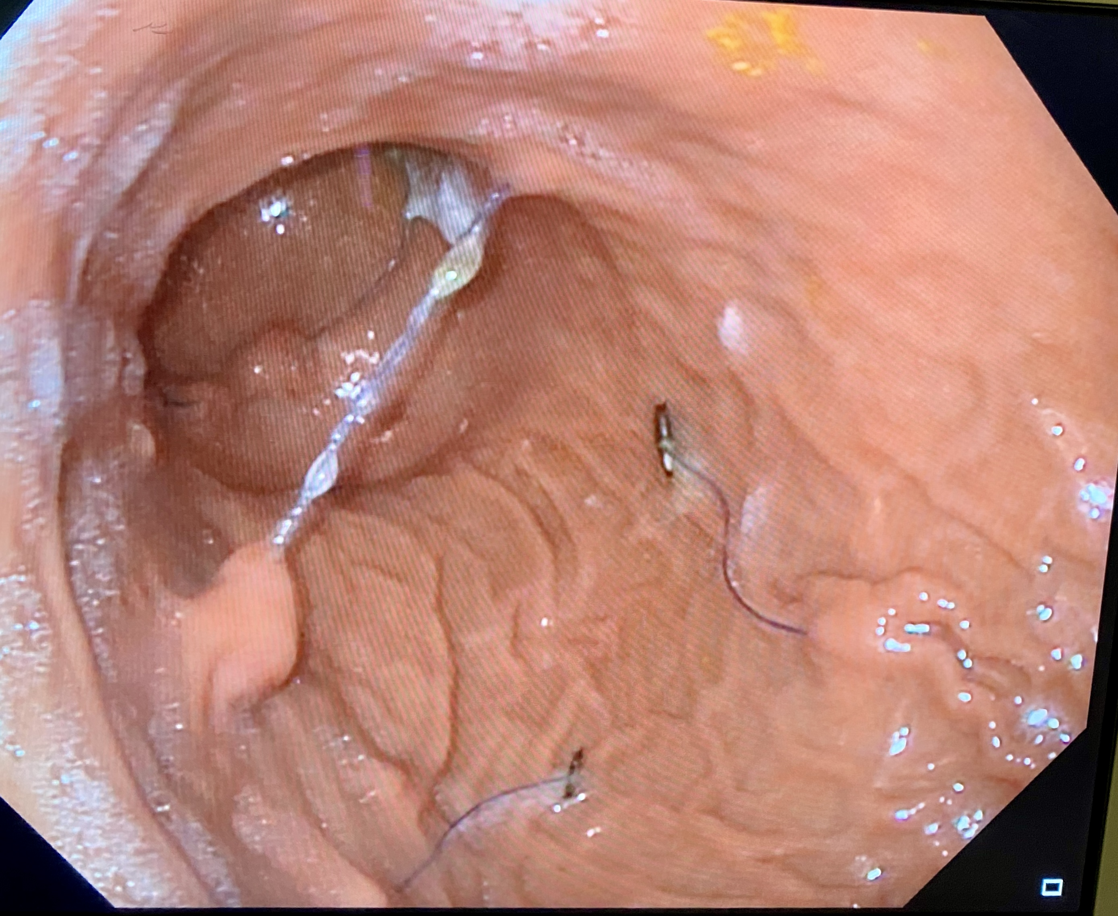
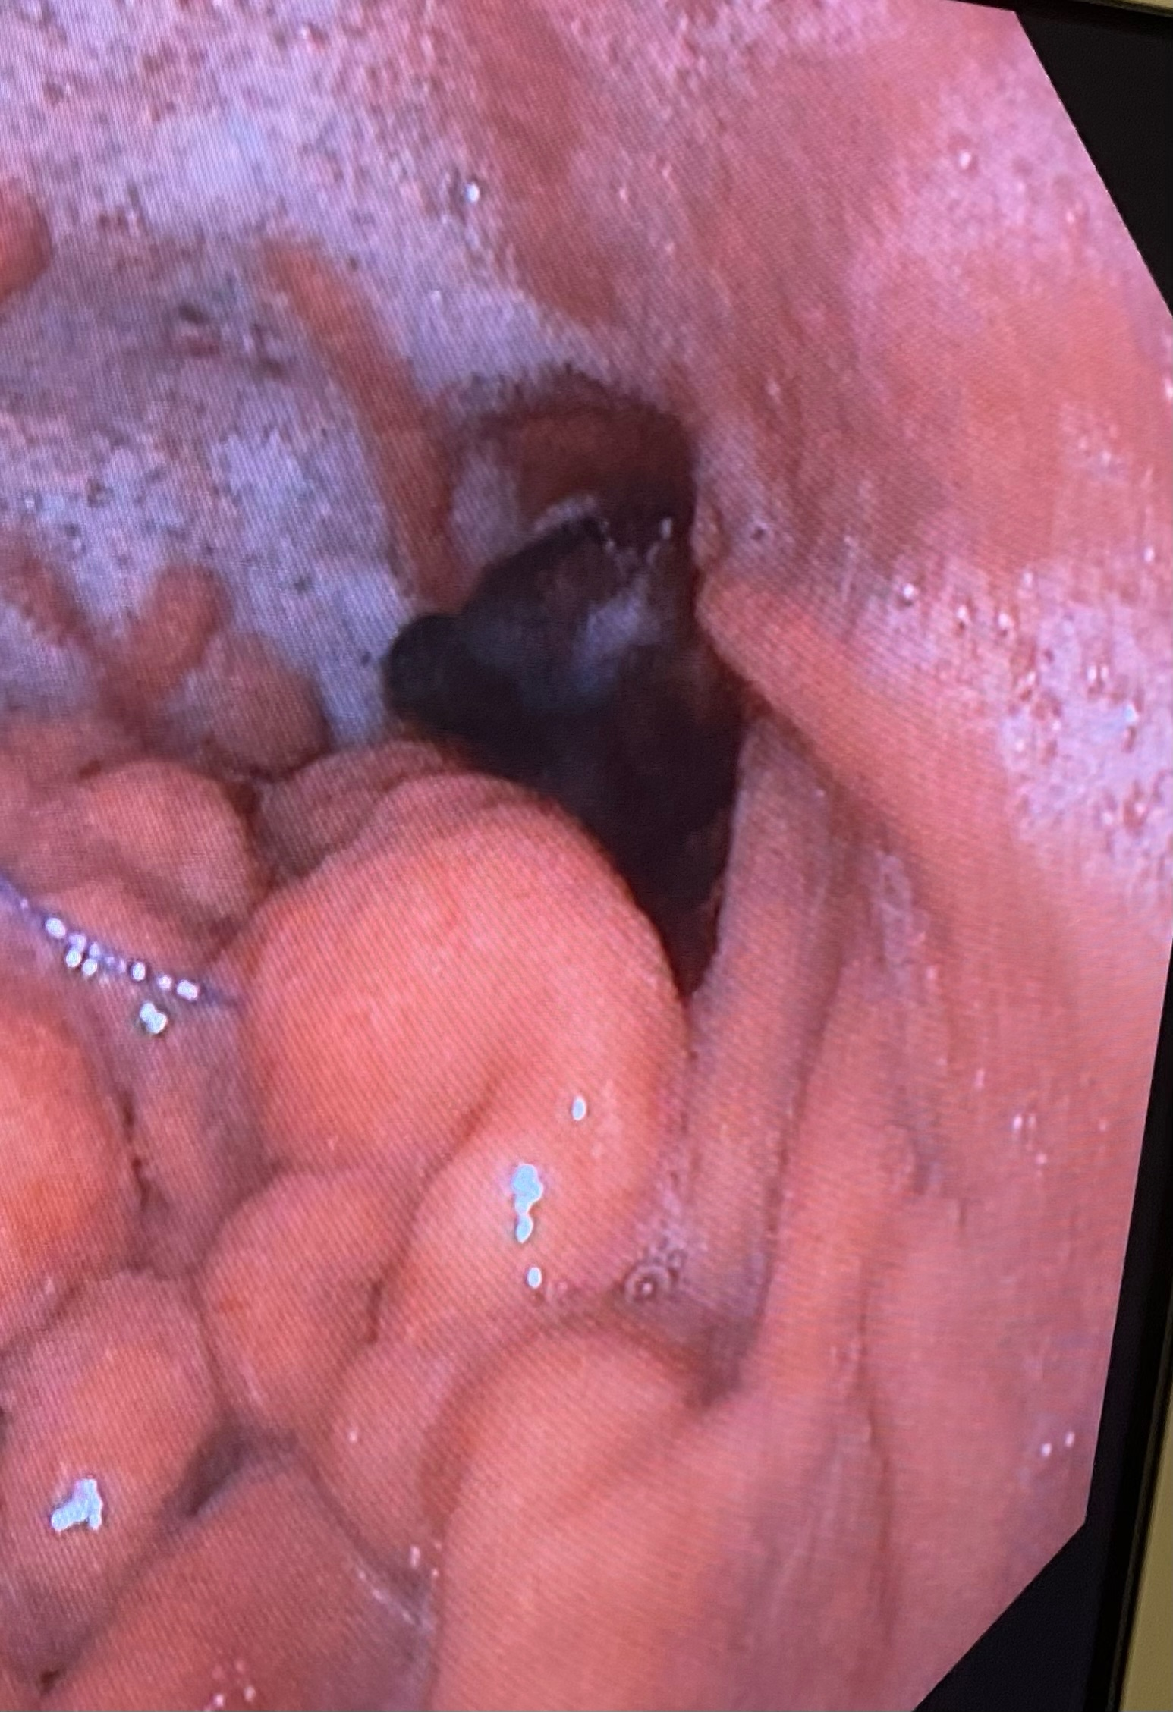
ESG in the time
Preoperative upper endoscopy
45% complete absence of gastroplasty
40% partialy intact gastroplasty
15% intact gastroplasty
Not published yet, Nedelcu et al
Courtesy Of Dr Marius Nedelcu

Slide 12

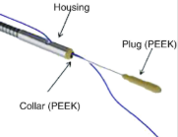
Surgery after ESG
Largest study published to date
58 reoperations
37 LSG
21 RYGBP
4 intraoperatives incidents, 1 postoperative bleeding and 1 leak
Not published yet, Nedelcu et al

Slide 13
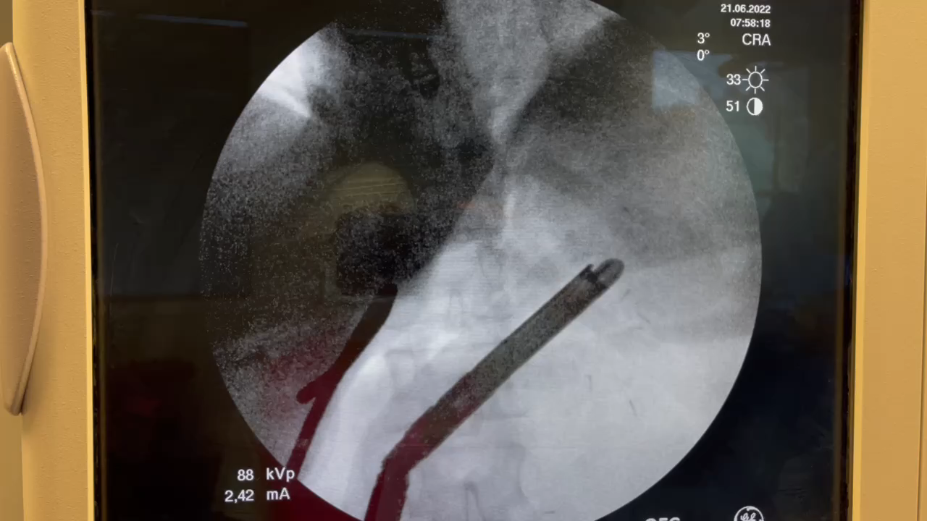
Surgery after ESG
Peroperatives additional techniques used
Fluoroscopy 28 cases (67%)
Gastroscopy 6 cases (14%)
Opening great curvatures 5 cases (12%)
Nothing 3 cases (7%)
Fluoroscopy in the operative room to avoid any crossing between the staples and the anchors
Courtesy Of Dr Marius Nedelcu

Slide 14
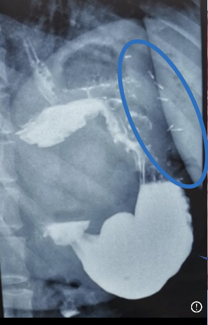
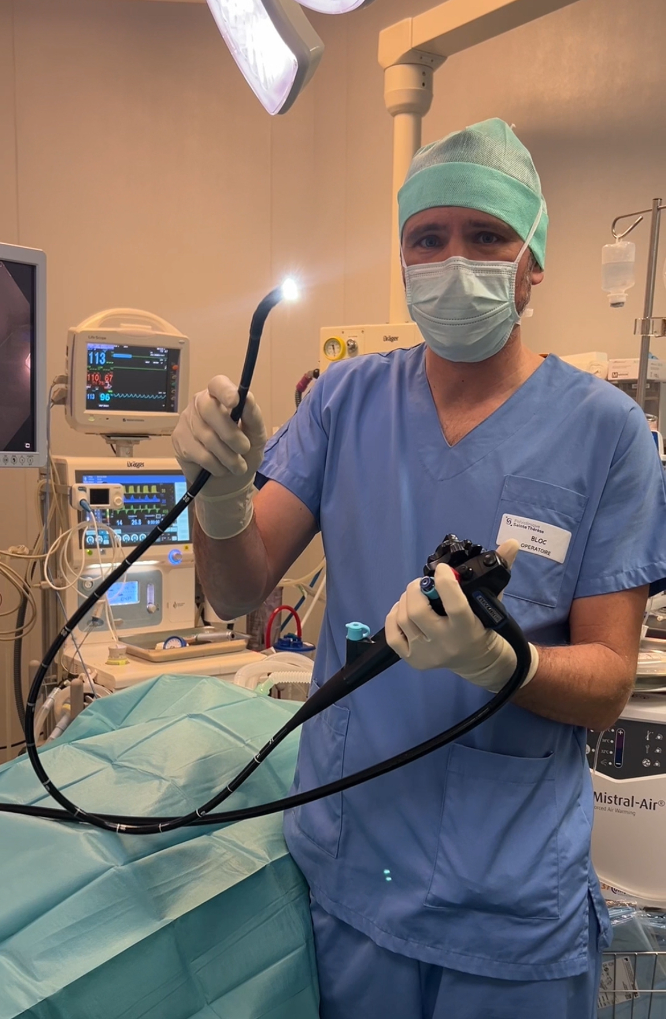
Surgery after ESG is possible and safe
Before conversion
Swallow evaluation
Gastroscopy +/- remove of T anchor
During conversion
Fluoroscopy
Gastroscopy
Consider gastrotomy
Better if you perform gastroscopy yourself
Do your own
endoscopy!

Slide 15
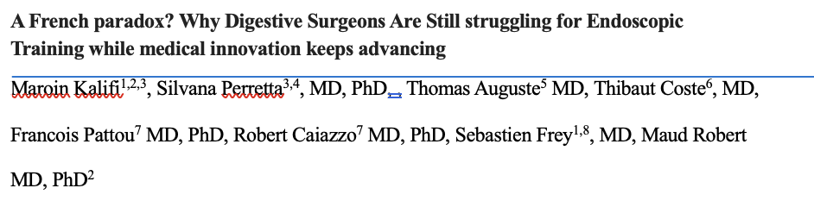
Flexible endoscopy and ESG takes effort
Access to endoscopy can be complicated for surgeons regarding your country
Education and training in endoscopy requires time and perseverance with multiple steps before doing the first ESG
Article not published yet

Slide 16
Context in France
No reimbursment for ESG (6000-7000€)
While MBS is covered by french healthcare insurance (CPAM)
Difficult to motivate patients
A surgeon is allowed to perform flexible endoscopy according to the law
But gastro enterologist (who historicaly performed flexible endoscopy) are mainly opposed to that and sometines are suing surgeon in front of medical council

Slide 17
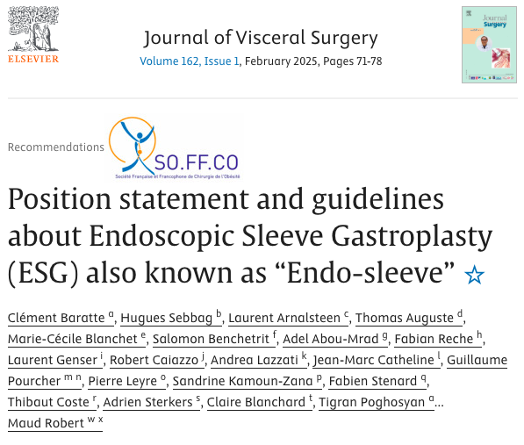
Context in France
ESG is endorsed by our scientific community but not included in recommandation of french healthcare system (HAS)
HAS recommend that a new technique must be performed within a scientific study (RCT or prospective)
Endoscopic Sleeve Gastroplasty (ESG) Prospective Trial for Obesity (Study « EGO-Trial » Pr Silvana PERRETTA) 2026
Qualité de l’investigateur | Nom et Prénom | Adresse du centre
Investigatrice Coordonnatrice | Silvana PERRETTA | Nouvel Hôpital Civil, Strasbourg
Investigateur Principal | Robert CAIAZZO | Hôpital HURIEZ, Lille
Investigateur Principal | Thibaut COSTE | Polyclinique Sainte Thérèse, Sète
Investigateur Principal | Pierre BLANC | Centre mutualiste de l’Obésité, Saint-Etienne
Investigatrice Principale | Venetia AVENDANO | Clinique les Eaux Claires, Baie-Mahault, Guadeloupe
Investigateur Principal | Fabien STENARD | Clinique des Cèdres, Echirolles
Investigatrice Principale | Marta SILVESTRI | Clinique Clémentville, Montpellier
Investigateur Principal | Hugues SEBBAG | Hôpital privé de Provence, Aix-en-Provence
Investigateur Principal | Henry-Alexis MERCOLI | Polyclinique de Franche-Comté, Besançon
Investigatrice Principale | Maud ROBERT | Hôpital Edouard HERRIOT, Hospices Civils de Lyon

Slide 18
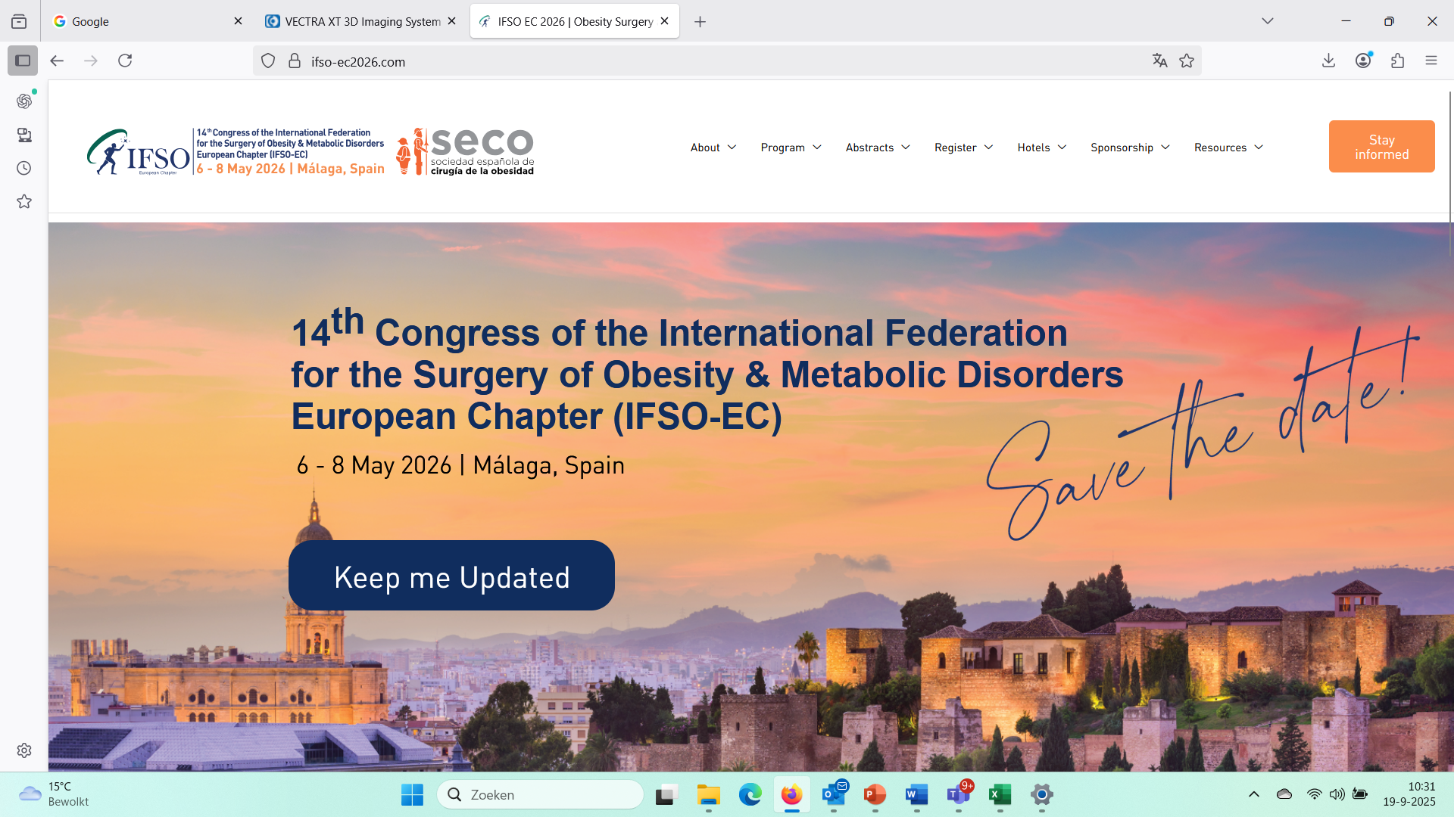
UEMS Exam Metabolic and Bariatric Surgery 6th May 2026
Become a Fellow of the European Board of Surgery in Metabolic and Bariatric Surgery

Slide 19
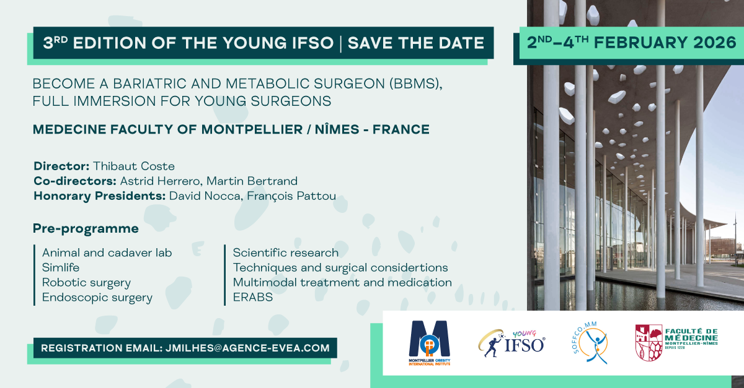
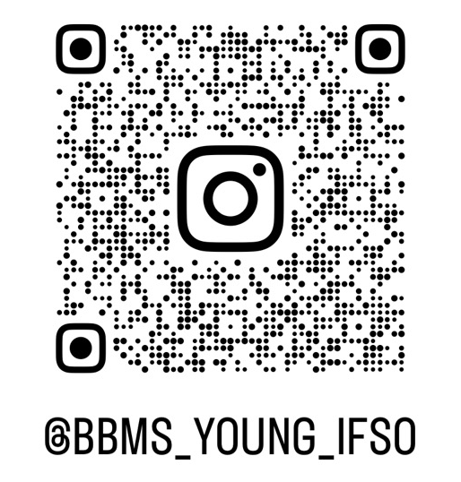
thibautcoste@gmail.com

